Slide 1
Business & Technical Ecosystem for Software Development
Securing your security
Malaysia is a lawless cyberland
Customers and employees have no rights

Slide 2
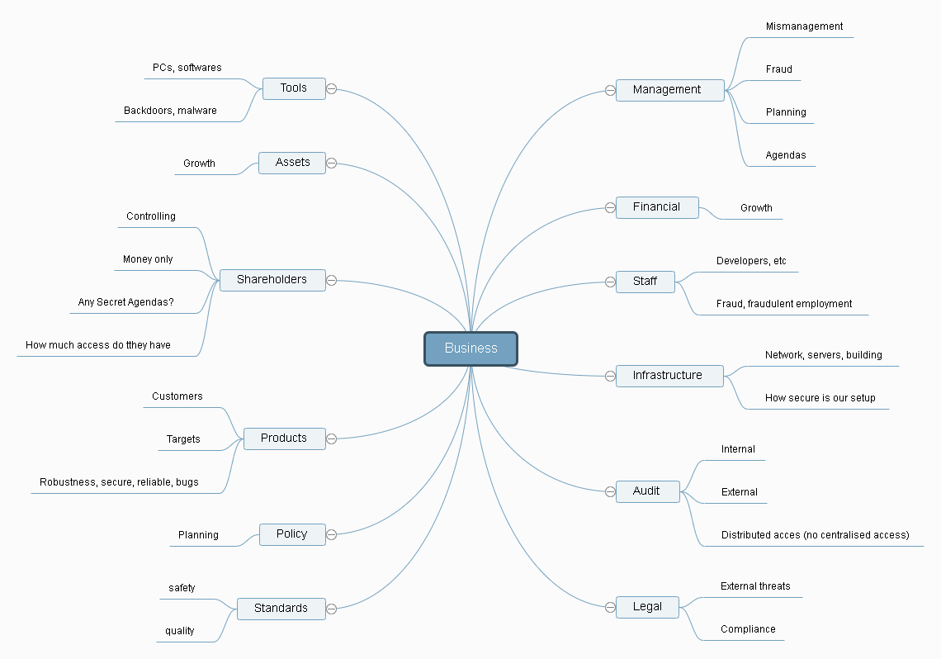
Security risks in a business

Slide 3
Security risks inside a company
Employment and staff (fraud on employment- fake CV and experience, internal regulations, staff practices, leakage of info (CIA contractors on linkedin), mismanagement of staff)
Equipment (delays (slow CPU?), reliability, functionality, setup)
Legal
Financial
Keeping up to date (continuous development and improvement of products, business methodologies and concepts)
Shareholders
Moral compass

Slide 4
Example cost distribution of a software development business

Slide 5
Caring for your assets
In a factory, you buy materials, process them in a building with manpower and equipment to create your product, in a software development company, your developers create your material, it is important to buy good materials too!
In a software development company, payroll can cost 70- 80% of your entire costs (Google 2017 spending)
Your developers must be able to grow as well, how you manage them is important
Fire HR that is afraid of those costs and want to reduce it. If you add costs of classic factories, payroll + input stream materials gives a similar cost
Losing your developers equates to losing your input and output stream
Developers worried about their future and pay will give in to bribes to leak secrets, will also have low productivity and quality.
Improve their data correlation ability

Slide 6
Examples: Nintendo and Activision
2018, Activision received record profits, but fired 800 developers and reduced existing wages while CEO got $15M bonus. Looks like the CEO is planning another cash out and short term exit.
2011,2014, Nintendo CEO halves own pay, same with the board “The deduction of the fixed compensation is what we volunteered to do in order to show our sincere attitude and to fulfil our responsibility,” as 3DS sales slumped says hard to maintain quality with layoffs and salary cuts. (just look at what they made recently)
Just because your product is finished it will still need to be updated regularly for security, features and performance other than bugs. Lay offs/cuts Puts pressure on existing developers which will reduce quality (important if you are a security company). Extra developer time can be diverted to free open sourced projects and improving product base. The 1st case would ruin the company and leave the customers with an unsupported product

Slide 7
Example: Breakdown of costs for a person in Malaysia (Software development is not cheap)
Vehicle (public transport still doesn’t allow you to get around fast)
- basic perodua myvi 1.3L manual, RM 42790 OTR 3 year repayment 10% loan rm1365 pm and 5k deposit – source perodua loan calculator
Rent/mortgage (10-15 years most common in Australia https://www.finder.com.au/home-loan-repayment-term). Assuming 500k basic property 15 years with 7% loan = rm2972 pm
Just property + vehicle = rm 4337pm (BNM living wage estimate of 4.3K way off)
Food and consumables?, Car and property maintenance?, Medical and insurance? Savings?
Student loan repayments? Family planning?
Desperate people make bad decisions and reduced productivity (i.e. dlink giving away its firmware keys)
Its not what the market rate is, not what a dumb BNM says, but how well can you grow the individual and the market, do you still want to pay a fresh grad developer rm 3k pm or pay based on single or married? An unmarried fresh grad may need to care for parents and family too or might marry the following year, needing to save up to have a family within 5 years.
Reason behind Malaysia’s brain drain
Salary is not how much you can make do to survive, but how much can you grow and do, not to spend on the business.

Slide 8
Investor and status independence
Chasing the investor and status is a fools gold, investors invest in you because they like what you are doing
Don’t chase status like MSC status, let them chase you, don’t use the status as a selling point,
Don’t lose focus on the foundation of your business, it needs to be kept secure
Don’t be afraid to lose noisy investors, they should be staff if they want to determine how things run and set goals
Investor legal, need to be careful on how much access shareholders can have even over customer data (i.e. personal information)

Slide 9
Legal and Financial threats
Competitors and more will also use ways to get your secrets or bring you down through other means
Example, corporate buyout, becoming a shareholder for access, using any legal means against you (Samsung vs apple, compare japan and US results)
Others will not play fair, documentation, evidence and good procedures and policies are important, can show not negligent as well.
Even for law enforcement, have to restrict their access (law enforcement aren’t morally incorruptible), documentation (despite their rejection) combined with procedure can help prevent secrets and data leaks if law enforcement can snoop around (example, who, when and what they access).
Activists like anonymous group can end up targeting innocent and say that they are guilty
Your financial performance is important to maintain growth and prevent staff from breaking

Slide 10
Problems detecting fraud
More than half fraud is only detected through whistle-blowers, audits tend to not catch them. Toxic work culture discourages whistle-blowers, causes losing good employees.
(example case, nurse reports on senior nurse never turning up to work, reports and said nurse gets fired, but work colleagues then hostile. The nurse has saved the company and product (not caring for the ill, what happens if they die on shift?) but the work culture caused her to lose her job.
Create a work culture that rewards whistle-blowers, if the rest of staff is hostile towards whistle-blowers, fire the hostile staffs and recruit new ones while keeping the whistle-blower.

Slide 11
Infrastructure planning
Your infrastructure must not be a bottleneck
Ensure you have more than enough resources
Limit different zones from communicating even if just a restaurant
Pick your hardware carefully, do your research
Clocking in is obsolete, even app based can be fooled (GPS, wifi hardware ID, …) and is inefficient, building entry security and terminal login is way better and more time efficient even for audit and proof
Check safety, no cables to trip over, no cables that will potentially have to handle more current than they safely can
Make use of VPNs, no resource/infrastructure access via WAN
Disaster planning

Slide 12
Picking the right tools
Avoiding uncurable compromised hardware (i.e. netgear, dlink, Huawei), compromised at design stage rather than distribution stage
Pick configurable network hardware
Have the right hardware specs that’s right for the job (more than sufficient hardware to reduce SDK inefficiencies, improve monitoring)
Cameras help documentation and evidence, not an anti privacy tool
Avoid wireless IO devices, many are unencrypted too

Slide 13
How much time is actually spent writing code?

Slide 14
Hostage situation preparedness
If you have something valuable, sometimes your staff can be used as pawns, their family could be kidnapped and they could be forced to sabotage your business.
Important to remember that, if someone is kidnapped, even if you do as they say they may still just kill the hostages, less likely if they find out that this method does not work if they lose their leverage quick, separating access permissions requiring more than 1 staff helps reduce this the chances of a kidnap leverage
If staff is compromised, temporarily using a holding cell (police) until situation is resolved is a solution.
If staff is compromised by bribe or opportunity, means your business was mismanaged.
Ransomwares are basically similar. Cold storage backups the best solution, don’t assume paying ransomware will work and assume data stolen as well
More important why personal details (addresses, contacts, social lives) are very risky to have stored. Never use your personal details in contact or online, always proxies.

Slide 15
Beating the industry and Market
Create a yearly financial and growth target, achieve a growth better than market (i.e. achieving 100% Return on cost per year, Walmart has approx 100% Return of cost per year with a 4x return on inventory)
Increase asset value over market (i.e. 10%+ salary increase per year, 50% skill increase per year of existing assets) can help retain developers and avoid losing them, keep your system updated with different benefits and opportunities as well
If you cant fulfil the salary requirements, explore another business avenue in software development. Your business performance is based on growth and a low salary contributes to economic problems (less rate of flow of money and less income for government)
Incentives and benefits to motivate loyalty and reduce discrimination (rather than salaries for families/singles, benefits instead such as free daycare, novated leases for vehicles and properties, financial and admin services, advice/psychologist) offer more value over just higher salaries, coupled with share options
Don’t fire, keep your developers and keep on improving your product even if it is finished. The tech market changes rapidly and security is important too to keep an eye on.
Don’t allow the investor to dictate terms
Malaysia is unsuitable for top tier industries that yield high returns. (why are we even considering computing here?) Go global straight away, be aware of legal ramifications and responsibilities and avoid lawsuits if others feel they can take you down for good. Malaysian GLCs and GOs do not consider you on your merits, more on who you know, foreign ones wont consider you because you aren’t local or don’t monopolise a product globally (i.e. Glaxo smith kline).
One entity’s mistake is your opportunity. i.e. china and cheap goods among a poor economy while others produce expensive poor quality goods

Slide 16
A more effective interview method example
How your interview setup would look like:
Skill test theory (use a service like IKMNET, Brainbench, hackerrank.com)
Skill test practical (example, tree search algorithm, see if they use threads, don’t give same exercises between applicants)
Skill test learning (give a simple exercise they haven’t done, see if they can do it and how fast they can learn something new, i.e. if they only do OOP give them a test in python, if they only do web, give them a task in C++)
Hidden psychology test (have lunch with them, 1 of the interviewers disguised as applicant to secretly interview)
Main interview – (the usual main questions, no point asking anything to do about technical, focus on getting to know the applicant and them getting to know you, Their attitude and personality are what you need to find here)
Scoring: Use skill test to prove whether or not they can do their job (don’t take their experience or qualifications as we never know how valid they were at that(i.e. indian job migration fraud in US)), use psychology to determine personality and score on how good a fit they are for the job. A good psychology will allow people to excel and work together better, including skill improvements and learning ability.
Another important skill, how much do developers use google to look things up

Slide 17
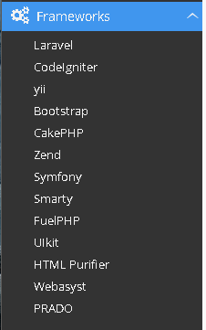
Frameworks
There are libraries, APIs, frameworks and ecosystems
Android is an ecosystem consisting of a collection of libraries and APIs extending the use of java on mobiles (before it was java MIDP language for older mobiles)
2 Different types of frameworks :
Frameworks that are developed after making various software (i.e. .NET)
Frameworks that are developed in anticipation of making various software
(many web frameworks)
Theory vs practice, practice is better

Slide 18
Issues plaguing todays software development
Do you contribute back to developing the framework/software you used?
Do you continuously train and improve your developers?
Do you consider your developers assets rather than regular hourly employees?
Do you have a good work culture with the right work life balance?
Do you list a framework as a job requirement? Framework creators don’t.
Are the right tools provided?
Don’t wait for the industry and government, lead on

Slide 19
OpenSSL case study - heartbleed
2014, a problem in openSSL called heartbleed was discovered. The developers mentioned that they had coded it in and knew about it but didn’t think much about it.
An example of the problems that opensource communities face
A lot of people use free opensource software but don’t contribute back either through development time or money
Without maintaining or improving the free products and frameworks that we use, how can we expect them to be a good choice for our products?

Slide 20
Developing using frameworks with open source
Do we contribute back to free opensource when we use? OpenSSL (2014- heartbleed, a lot of organisations huge and even military used openSSL but did not contribute back to further developing it)
Is the framework in question suitable for our product platform (not using web languages for mobile app development)
Is the framework’s goals in line with our goals
Does the framework fulfil the common goals of a framework (cost, Time, robustness)?

Slide 21
Re-investing
If we use frameworks and other free software as part of our products, it also means that we are responsible for maintaining those frameworks as well
There is no get out of jail free card, nothing is free but the world has made things easier for people to start
Same goes for any software or tool we use, contributing back to things that has helped bring us money

Slide 22
Differences in developing mobile apps
Know your hardware (ARM CPUs have less cache and registers than x86, even intel atoms and AMD equivalents, followed by lower IPCs and higher branching penalties). However The ARM pipeline allows for optimised simpler instructions. Web code requires more cache and better branching performance.
Variations, people run different OS versions, different hardware variations and limitations. Java EE is far more suitable than web based frameworks to meet the backend requirement especially if security is concerned.
Reducing code size and overheads is key, thread asynchronously as much as you can and prioritise predefined and static code to make the most of the ARM pipeline.

Slide 23
Why not to use frameworks
It makes our developers dumber by not knowing the fine details of various underlying systems that we should know about and optimise for when developing our product
Many tend to be in a programming language unsuitable for your product, web based languages run poorly on RISC and have a higher memory footprint requirement (more cache and ram needed)
Tools provided by manufacturers are the best to use (why use cordova when android studio is better and offers kotlin for web programmer freaks)
Creates unwanted overhead in staff (increased time for new staff to adapt)
Has become a bad culture (if a framework has become a job requirement, it is a bad framework)
Are you that unskilled as a programmer?
Many using frameworks unsuitable for their product, cant offer consistency and error handling, even security can be questionable

Slide 24
When to use a framework
After you have developed your product. I copy a lot of code, but only 20% of it stays the same, adding a framework only increases the code size increasing the required memory footprint. If you have 2 products that share the same code, that is when a framework helps.
The framework provides tools that allow us to focus on programming, our product like .NET and what is covered is not in scope i.e. raw low level socket handling with network design while allowing the full features and use of the programming language. Example use case, networked products so even works well over bonded NICs.
The framework is developed as a late add in over multiple products
Does not shield you from having to understand the covered low level details

Slide 25
What sort of frameworks to consider
Do your research, frameworks should be added late when the product is developed as you would then know the requirements well, know the limits and impact of using a specific one
Different programming languages work differently, have different advantages/disadvantages even if compiled into another languages
Know your product platform well
Frameworks that are made for use at the start of development are pipe dream attempts from foolish programmers/management
Don’t be taken in by the pretty ads of frameworks, except for CSS frameworks, consider a framework through its
Programming language
How close its goals align with yours
You plan to maintain the framework too
Does not hide the low level details we should know about

Slide 26
Example cases of using frameworks
Mobile app development, can consider Xamarin for cross platform because of the C# language is not a web language, more suitable, but will not be able to take advantage of what specific platforms offer (which native coding can do),
Keeping web frameworks to the web, use system programming languages for anything outside the web, java EE is more suitable as a multi platform backend than a php or js based framework.
When its not for your product (your business can run without it i.e. que reference system, knowing the current number remotely).

Slide 27
When to use a framework on mobile
When the app is not part of your product (i.e. simple que system, business card app), similar to websites too.
The software is not important, everything operates normally without the app or software
Your developers are so unskilled and unable to learn that they can only do JS, JSX, PHP, css but not kotlin which is more suited for web developers, and you are unable to get better developers (basically its meant for non coders)

Slide 28
Tips
Don’t try to copy another business, don’t make another lazada, mudah, google etc not like you can do better than or compete with them
Compensate your employees if they spend money while doing business, otherwise they are liable for shares as they have put money in. Even if having to buy water for office.
Avoid personal items in business, can allow using personal laptops but proper tools must be provided (correctly spec PCs not intel atoms or dual core low power PCs). If an employee uses their own tool because no suitable tool was provided, they are already liable for shares/compensation.
Salaries are not there for your employees to use while working
Know your legal, procedures and requirements, always do better than them (i.e. honda and safety, Google and security)
Don’t feed your staff chemically induced foods like nescafe or local coffees roasted with margarine, their brains are important
Do not wait for Malaysia to get its laws and authorities right or to stop being lawless in various departments, make use of international bodies and laws if necessary and take the lead in doing better than others rather than only being barely compliant.
Many agreements cant be enforced if found to be unfair/misleading, etc so don’t bet on employees and clients signing unfair contracts, documents, agreements, etc. A single phone call or complaint to the UN or activists can put your business and the country in trouble and unfair contracts do not hold up in court.

